Slide 1
COVID-19 Testing- All hands on deck
KRemley
5/8/20

Slide 2
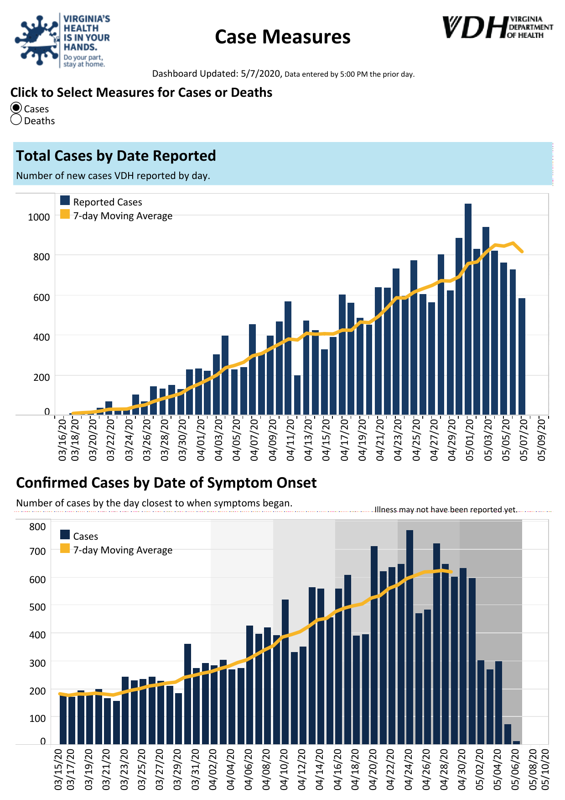

Slide 3
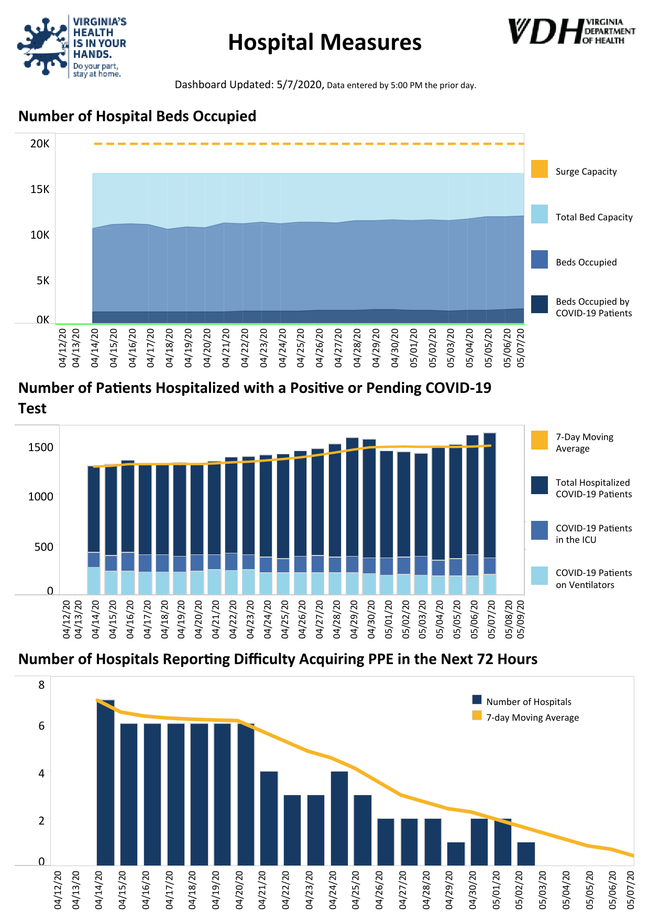

Slide 4
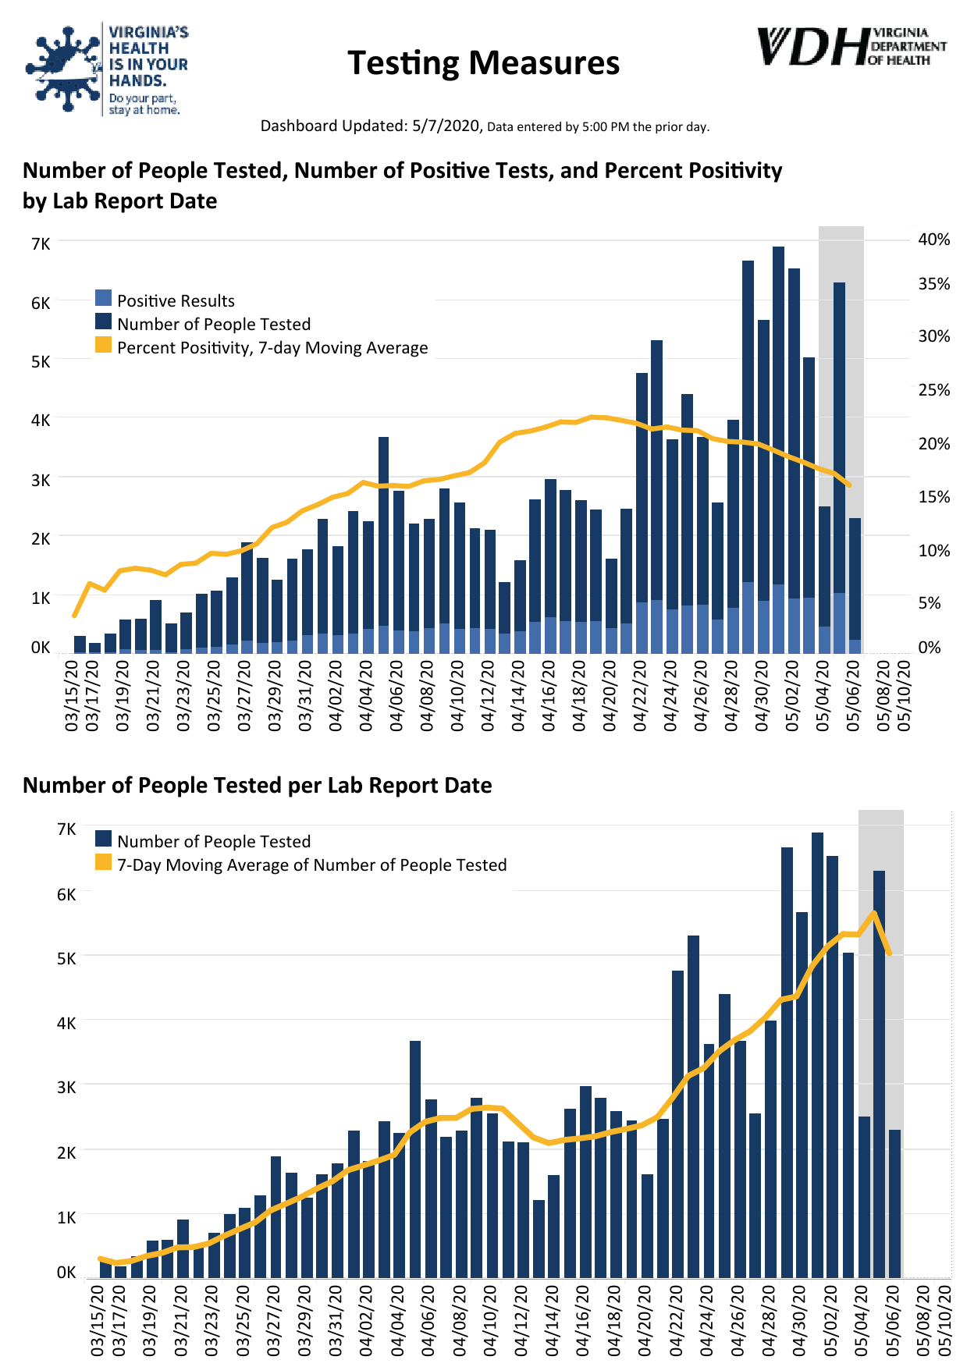

Slide 6
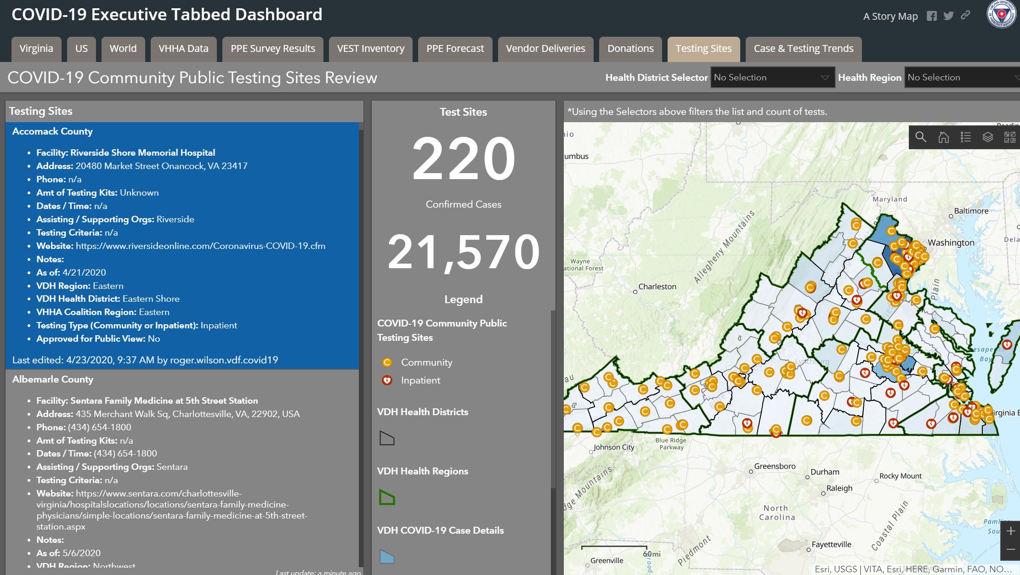

Slide 7
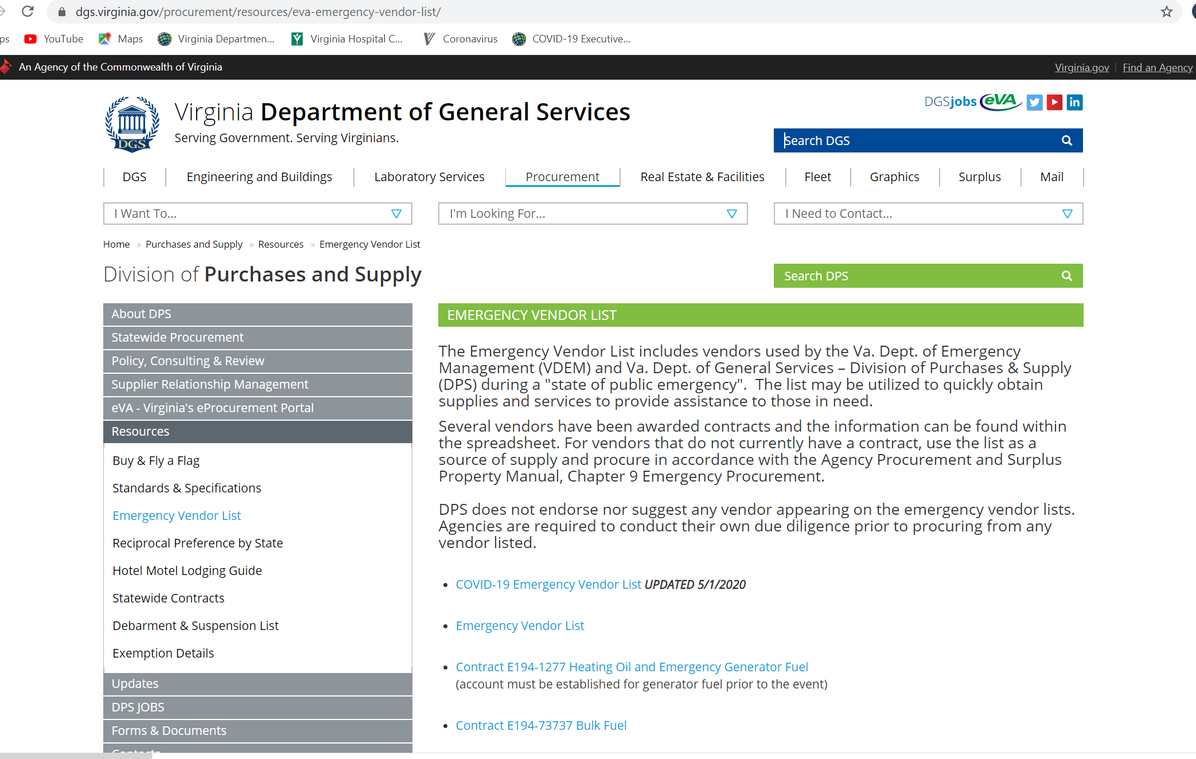

Slide 8
Video on how to do a healthcare worker observed COVID-19 test

